Slide 1

Introduction to HTML and HTTP Requests
Mini Coding Bootcamp @ Belkin
May -2021

Slide 2
What is the internet?

Slide 3
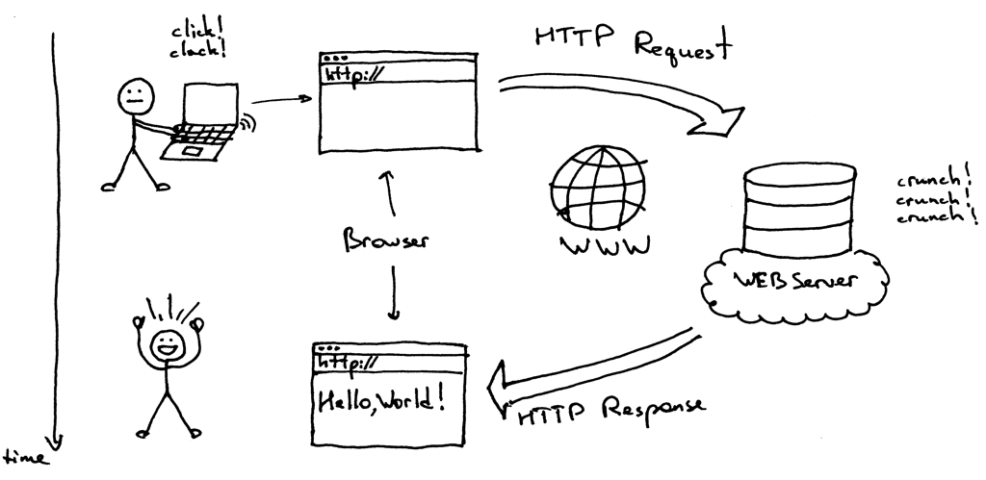
How does the Internet work ( Clients and Servers )
TCP/IP – A set of protocols for sending and receiving data using packets and addresses
Client – A program that ‘connects’ to servers to start communication web browsers are a client program
Server – A program that ‘accepts’ connections from client programs web servers handle connections from a web browser

Slide 4
traceroute
For MAC:
Open Network Utility
Click “Traceroute”
Enter a domain name
Click “Trace”
For PC:
Open Command Prompt
Type: “tracert” followed by a space and then the domain name for which you want to perform a traceroute

Slide 5
HTTP Requests
HTTP stands for Hypertext Transfer Protocol.
HTTP works as a request-response protocol between a client and server.
The most commonly used HTTP methods are POST, GET, PUT, PATCH, and DELETE

Slide 6
How a website is loaded in our browser

Slide 7
Data Center

Slide 8
What is HTML?
HTML stands for Hyper Text Markup Language
HTML describes the structure of a Web page
HTML elements tell the browser how to display the content
HTML elements are represented by tags
HTML tags label pieces of content such as "heading", "paragraph", "table", and so on
Browsers do not display the HTML tags, but use them to render the content of the page

Slide 9
HTML Tags
HTML tags are element names surrounded by angle brackets:
<tagname>content goes here...</tagname>
<!DOCTYPE html>
<html>
<head>
<title>Page Title</title>
</head>
<body>
<h1>My First Heading</h1>
<p>My first paragraph.</p>
</body>
</html>

Slide 10
XMLHttpRequest
XMLHttpRequest is a built-in browser object that allows to make HTTP requests in JavaScript.
1. Create XMLHttpRequest:
var Http = new XMLHttpRequest();
2. Specify the main parameters of the request:
Http.open("GET", url);
3. Send it out.
Http.send();

Slide 11
XMLHttpRequest
4. Listen to HTTP events for response.
load – when the request is complete (even if HTTP status is like 400 or 500), and the response is fully downloaded.
error – when the request couldn’t be made, e.g. network down or invalid URL.
Http.onload = function() {
alert(`Loaded: ${Http.status} ${Http.response}`);
};
Http.onerror = function() {
// only triggers if the request couldn't be made at all
alert(`Network Error`);
};

Slide 12

Making HTTP Request with IFTTT Webhook API
Free platform that lets you create connection between different web-service and applications
Stands for ‘If this, then that’
A combination of a TRIGGER and an ACTION
Examples:
If the sensor is triggered, send me a message
If the garage door is opened, turn the living room lights on

Slide 13
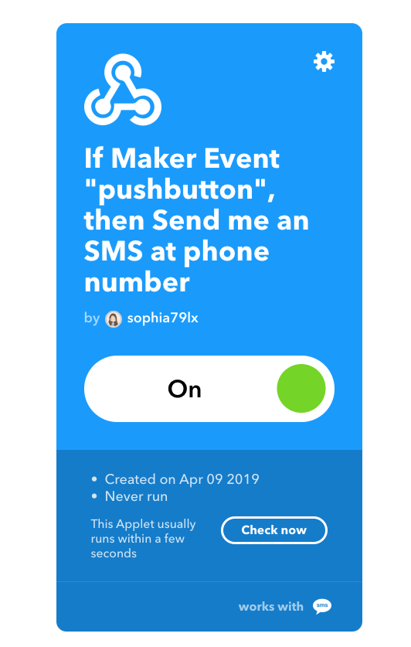

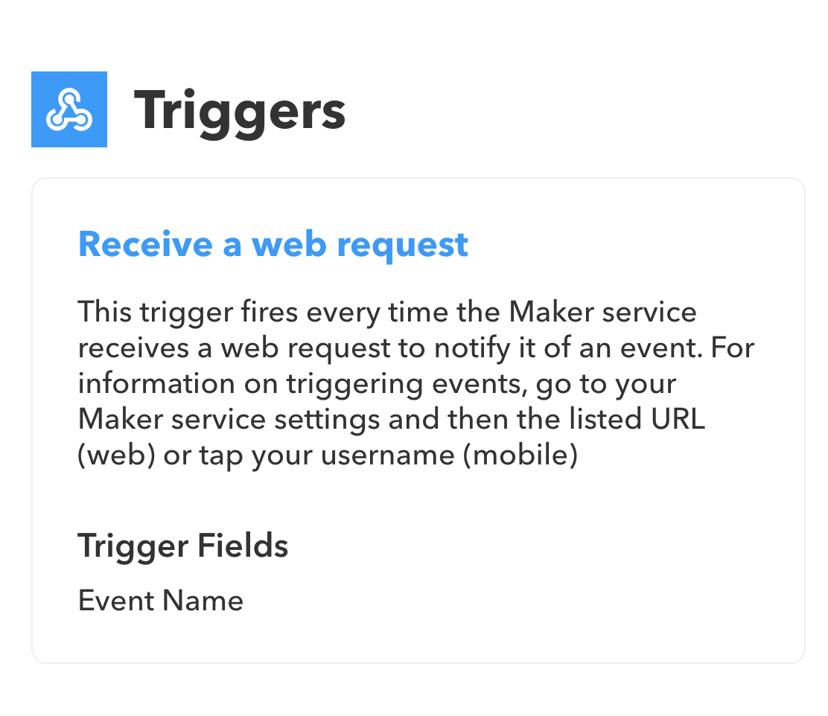
Step 1 Create an account on https://ifttt.com/
Step 2 Create an IFTTT Webhook

Slide 14
THANK YOU

